Slide 1
Developing Apps for Touch and Mobile Devices

Slide 2
Objectives
In this session, you will learn to:
  Manage app data using mobile services
  Authenticate users of an app using mobile services

Slide 3

Modifying Data in the Mobile Service
Azure Mobile Services allows you to modify data or update data in the mobile service.
To update data, you need to use the update() function.
For example, consider the following code snippet:
var updateContactItem = function (contactItem)
{ contactTable.where({ name: tbName.value }).read().done( function (results) {
if (results != null) { contactTable.update({ id: results[0].id, Name: "Allen", phone: results[0].phone, email: results[0].email, location: results[0].location
}).done();
}
});
};

Slide 4

Deleting Data in the Mobile Service
You can delete data in a mobile service by using the del() function.
The del() function deletes an existing item in the table.
For example, consider the following code snippet:
var deleteContactItem = function (contactItem)
{
contactTable.where({ Name: tbName.value }).read().done(
function (results)
{
if (results[0].Name != null)
{
contactTable.del({ id: results[0].id }).done();
}
});
};

Slide 5

Searching Data by ID
You can retrieve specific rows by using the value stored in the id column of a mobile service table using the lookup() function.
This function accepts the value of the id column and retrieves the respective row from the table.
For example, consider the following code snippet:
var searchContactByID = function ()
{
contactTable.lookup(tbSearchText.value).done(function
(results)
{
//Code to display the retrieved data in the user interface
}, function (err)
{
//Code to handle error
});
};

Slide 6
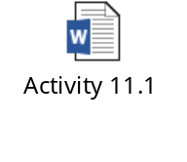

Activity 11.1: Managing App Data Using Azure Mobile Services
Problem Statement:
Solution:
To complete this activity, you need to perform the following steps:
  Create a Windows Azure Mobile Service.
  Create a table storage.
  Connect the app to mobile service.
  Insert app data in mobile service.
  Retrieve data from mobile service.
  Update data stored in mobile service.
  Delete data stored in mobile service.
  Search data stored in mobile service.
  Execute the app and verify the output.

Slide 7
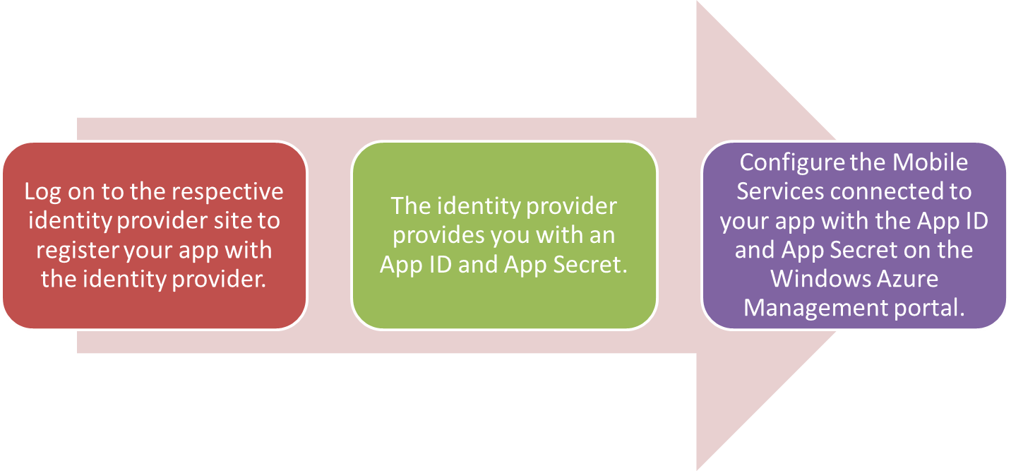
Authenticating Users of the App Using Mobile Services
The steps to enable users to use the credentials of any of the identity providers to access your app are:

Slide 8
Registering an App and Configuring Mobile Services for Authentication
To enable users to use the credentials of any of the identity providers to access your app, you first need to register your app with the specific identity provider.
For this, first you need to log on to the respective identity provider site. For example, to register your app with Facebook, you need to log on to the developers.facebook.com website.
When you register an app with an identity provider, the identity provider provides you with an App ID and App Secret.
You need to configure the Mobile Services connected to your app with the App ID and App Secret on the Windows Azure Management portal.

Slide 9
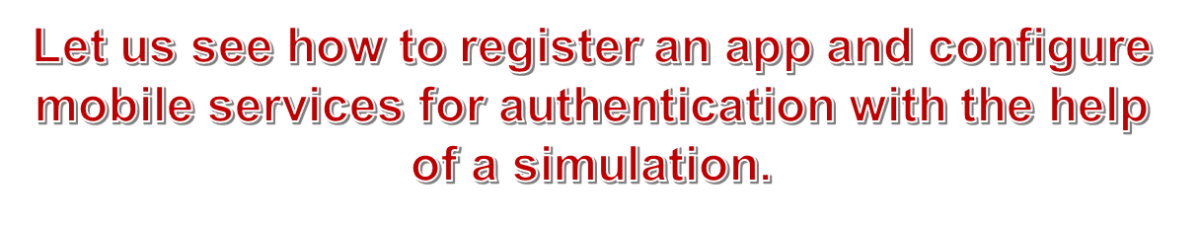
Task 11.4: Registering an App and Configuring Mobile Services for Authentication

Slide 10
Restricting Table Permissions to Authenticated Users
By default, all requests to the mobile service resources are restricted to clients that present the application key, which does not strictly secure access to resources.
To secure your resources, you need to restrict access to authenticated clients.
You need to update the configuration settings of the tables that store app data in Mobile Services.

Slide 11

Task 11.5: Restricting Table Permissions to Authenticated Users

Slide 12

Adding Authentication to the App
After you have registered the app and configured Windows Azure Mobile Service, you need to add authentication with the specific identity provider, using the login() function.
For example, consider the following code snippet:
var loginId = null;
//Request authentication from Mobile Services using //Google login.
var clientLogin = function () {
return new WinJS.Promise(function (complete) {
MyContactBookClient.login("google").done(function (results) {
loginId = results.userId;
//Authentication successful
//retrieve the data from mobile
//service here
}, function (error) {
loginId = null;});
});}

Slide 13

Adding Authentication to the App (Contd.)
var authenticate = function ()
{
clientLogin().then(function ()
{
if (loginId === null)
{
// Authentication failed, try again.
authenticate();
}
});
}
authenticate();

Slide 14

Activity 11.2: Authenticating Users of the App Using Mobile Services
Problem Statement:
You have created the My Contact Book app that allows users to add, update, delete, and search for contact details. Because the app stores personal and confidential information, you want only authenticated users to perform the preceding task while using the app. However, instead of writing code in your app to create an interface to authenticate users, you want that the users are able to use their Google credentials for authentication. How will you accomplish this task?
Solution:
To complete this activity, you need to perform the following steps:
  Register the app and configure mobile services for authentication.
  Restrict table permissions to authenticated users.
  Add authentication to the app.
  Execute the app and verify the output.

Slide 15

Just a Minute
Which one of the following types of objects is used to invoke the login() function during client authentication?
Identity provider
Mobile service client
Mobile service table
Answer:
2. Mobile service client

Slide 16
Summary
In this session, I learned that:

